Slide 1


Cyclistic
BIKE-SHARE
Google professional data analysis graduation project
By / Mohamed Mahmoud Hasan

Slide 2

Created By
I'm Mohamed Mahmoud Hasan, and it's a pleasure to be here with you today solving the Google case study problem
About Me
- Bachelor’s degree from Ain Shams University
-Google Professional Data Analysis Certificate
-Applied Deep Learning Engineer specialization from Mahara Tech
-Proficient in Statistics (Descriptive, Inferential)and linear algebra
-Financial Analysis Statement Knowledge
-Programming Languages: Python and R
-Structure languages: SQL -Data Visualization Tools: Power BI, Tableau, Looker

Slide 3

Data analysis is the process of systematically inspecting, cleaning, transforming, and interpreting data to uncover meaningful patterns, trends, and insights that support informed decision-making

Slide 4
Introduction
Business Requirements
Aim of the project
Database Description
Methodology
Data preparation
Conclusion and
Recommendations
Agenda

Slide 5
Introduction

Slide 6
Introduction
A bike share program consists of making bicycles available to the inhabitants of a city so that they can rent a bike for short or longer distances. In particular, shared bikes are used to go to work, the gym, to school, and to meet friends
And in this project we have
Cyclistic: A bike-share program that features more than 5,800 bicycles and 600 docking stations. Cyclistic sets itself
apart by also offering reclining bikes, hand tricycles, and cargo bikes, making bike-share more inclusive to people with
disabilities and riders who can’t use a standard two-wheeled bike. The majority of riders opt for traditional bikes; about
8% of riders use the assistive options. Cyclistic users are more likely to ride for leisure, but about 30% use them to
commute to work each day.

Slide 7
Business Requirement

Slide 8
Business Requirement
Requirements
How do annual members and casual riders use Cyclistic bikes differently?
The Directors
The director
of marketing believes the company’s future success depends on maximizing the number of annual memberships. Therefore,
your team wants to understand how casual riders and annual members use Cyclistic bikes differently
Limitations
Limited project timeline due to business needs and resource availability
Limited availability of data due to data privacy and security concerns

Slide 9
Aim of the project

Slide 10
Aim of the project
Develop a comprehensive Data analysis solution that meets the business requirement and stakeholder and directors' needs
Provide actionable insights and recommendations to increase the number of members and increase profitability
Understanding the members and casual behaviors to improve the business

Slide 11
Database Description

Slide 12
Database Description
The datasets have a different name because Cyclistic is a fictional company. For the purposes of this case study,
the datasets are appropriate and will enable you to answer the business questions. The data has been made available by
Motivate International Inc. under this license.)
Public data: The data being used is publicly available, which means it can be accessed and explored by anyone interested in analyzing how different customer types are using Cyclistic bikes.
Data privacy: There are data-privacy issues associated with the dataset, and it is crucial to acknowledge and respect them. The description specifies that personally identifiable information (PII) of riders, such as credit card numbers, is not included in the dataset.
Limitations: Due to the absence of PII, certain analyses might not be possible. For example, it won't be feasible to connect pass purchases to credit card numbers to determine if casual riders live in the Cyclistic service area or if they have purchased multiple single passes

Slide 13
Methodology

Slide 14
Methodology process
Ask
prepare
Process
Analyze
Share
Act

Slide 15
Asking effective question
The main question is How do annual members and casual riders use Cyclistic bikes differently?
----Comparing behaviors between annual members and casual riders, including the following information:
a. The total number of riders in the last 12 months.
b. The number of annual members.
c. The number of annual members for each type of bike.
d. The number of casual riders for each type of bike.
e. The most common day of the week for members and casual riders to use the bikes.
f. The most frequently used starting point for members' rides and the corresponding number of riders.
g. The most common ending point for members' rides and the corresponding number of riders.
h. The most common starting point for casual riders' rides and the corresponding number of riders.
i. The most common ending point for casual riders' rides and the corresponding number of riders.

Slide 16
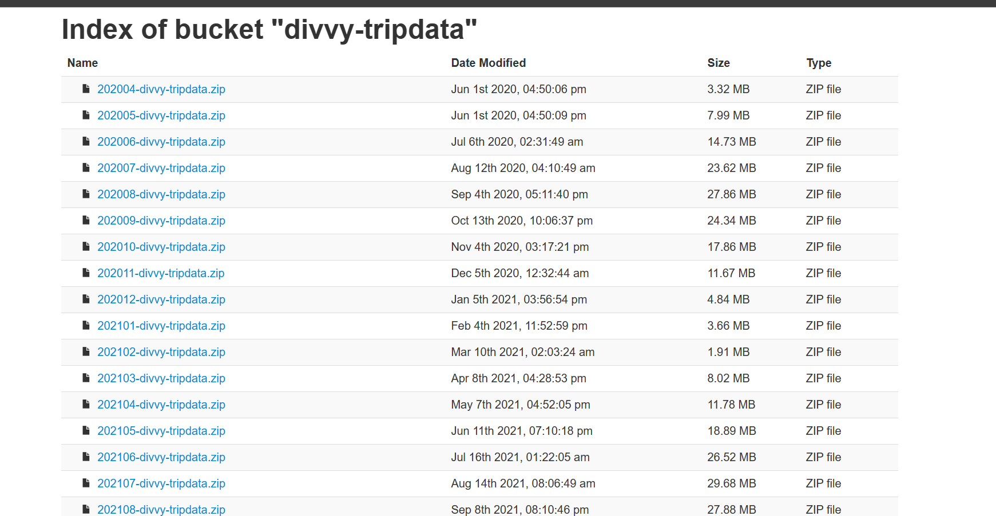
Data preparation

Slide 17

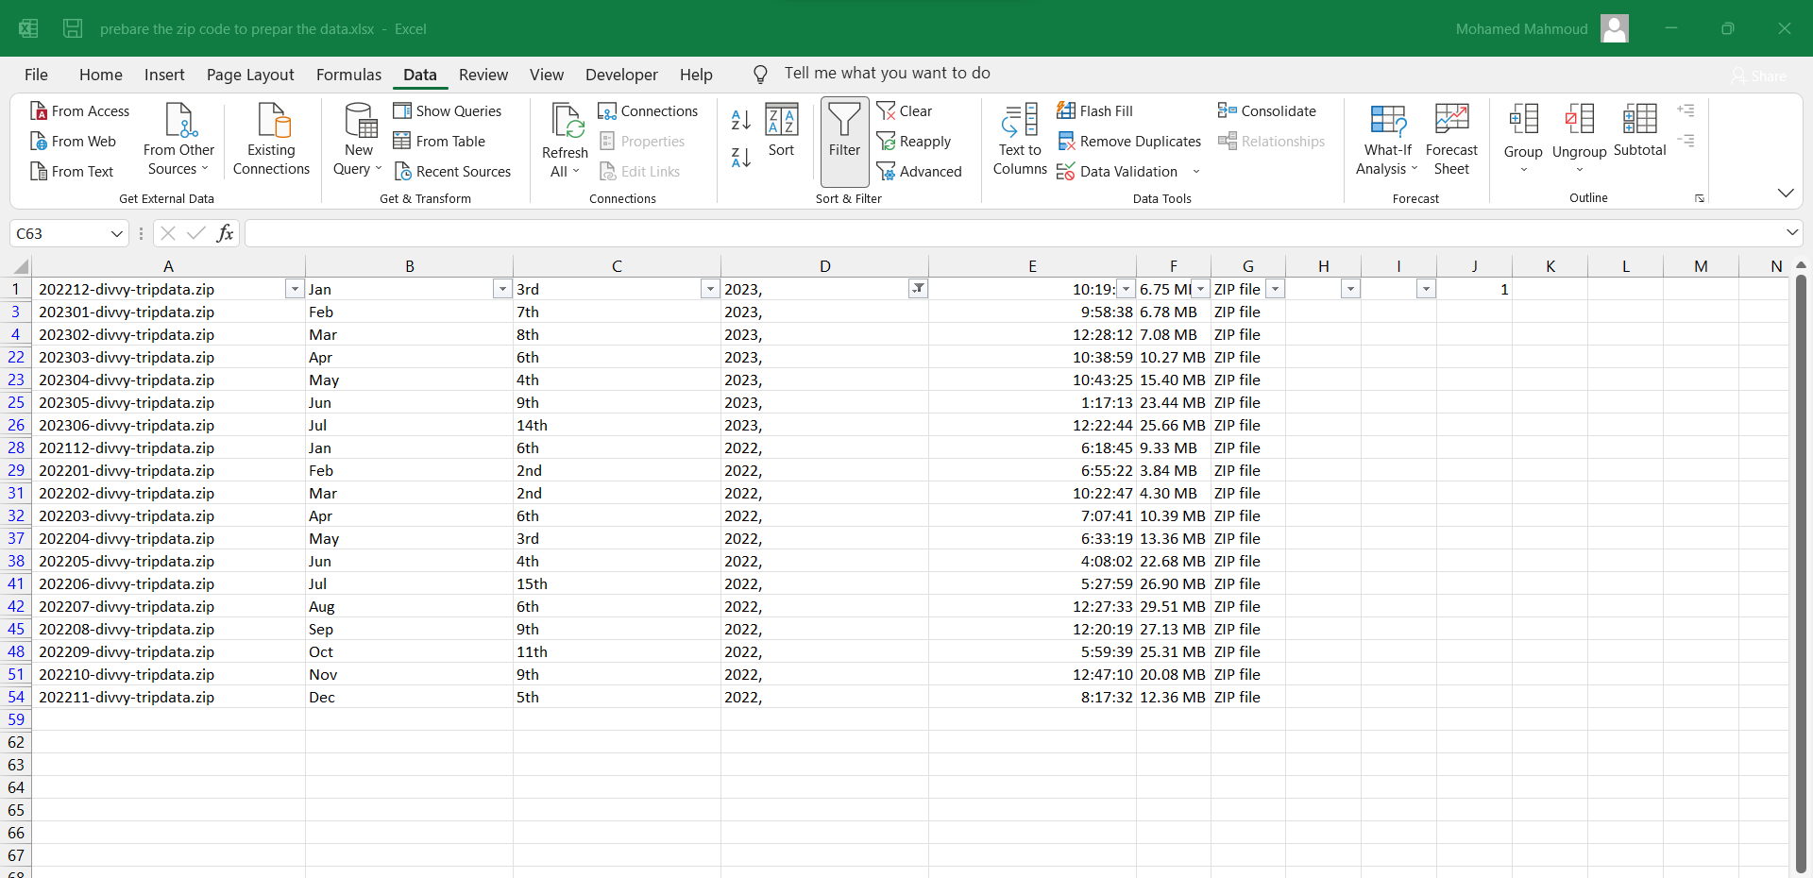
Then we needed to arrange all the files names and dates in an Excel sheet because we have 58 zip files, and I only need the data from the last 12 months.

Slide 18
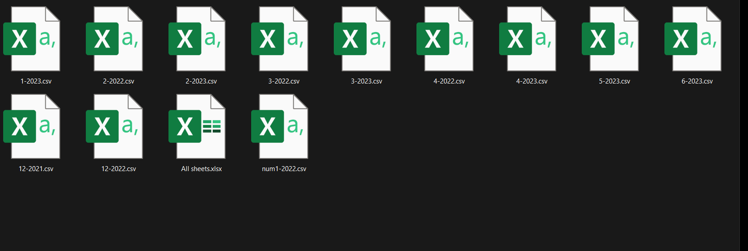
After that, I needed to convert the sheets into one workspace format and then sorted them by date in a folder

Slide 19
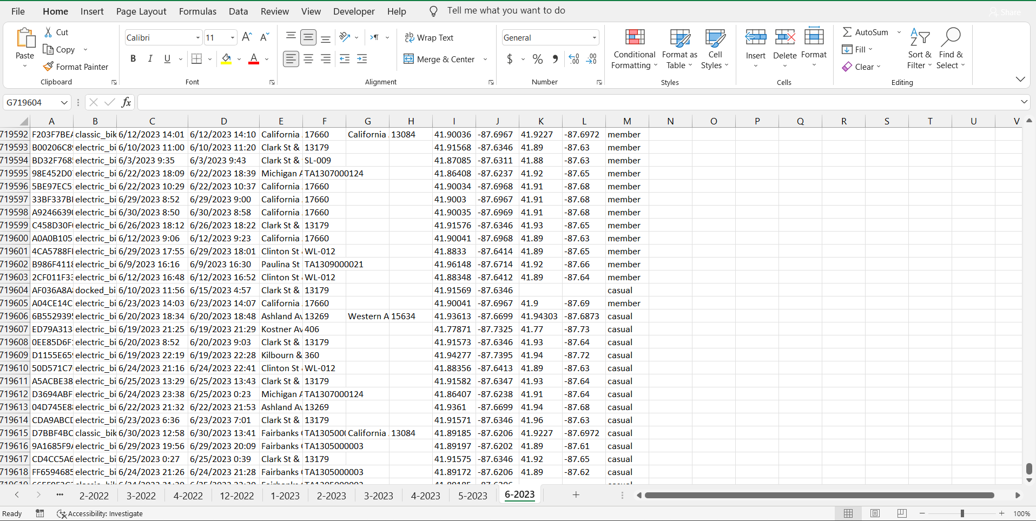
After completing the previous tasks, I loaded all the sheets and organized them into one workspace. Then, I applied the ROCCC process to my data.

Slide 20
Data processing
"In this step, I used Excel to perform the following tasks:
Deleted missing data.
Ensured there are no duplications in the ID to calculate the number of users.
Changed the data type to be appropriate.
Created a column for the number of day.
Created a column for the name of the day.
Created a column for the time difference to know the time taken between the start time and the end time, in order to determine the duration of the trip."

Slide 21
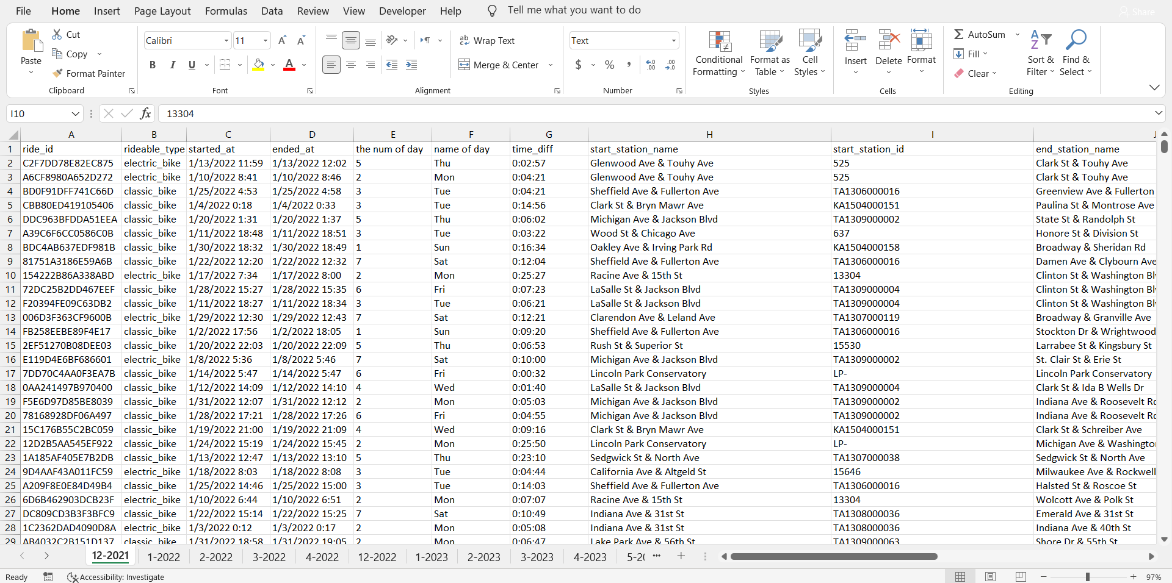

Slide 22

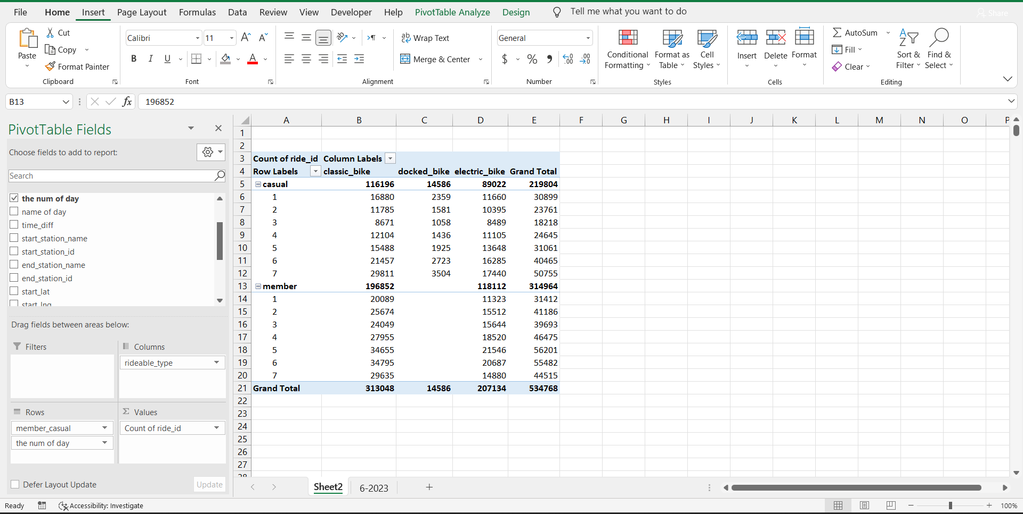

Analysis step
I used a pivot table (Excel) and visualization (Power Bi ) to analyze and understand more about the data

Slide 23
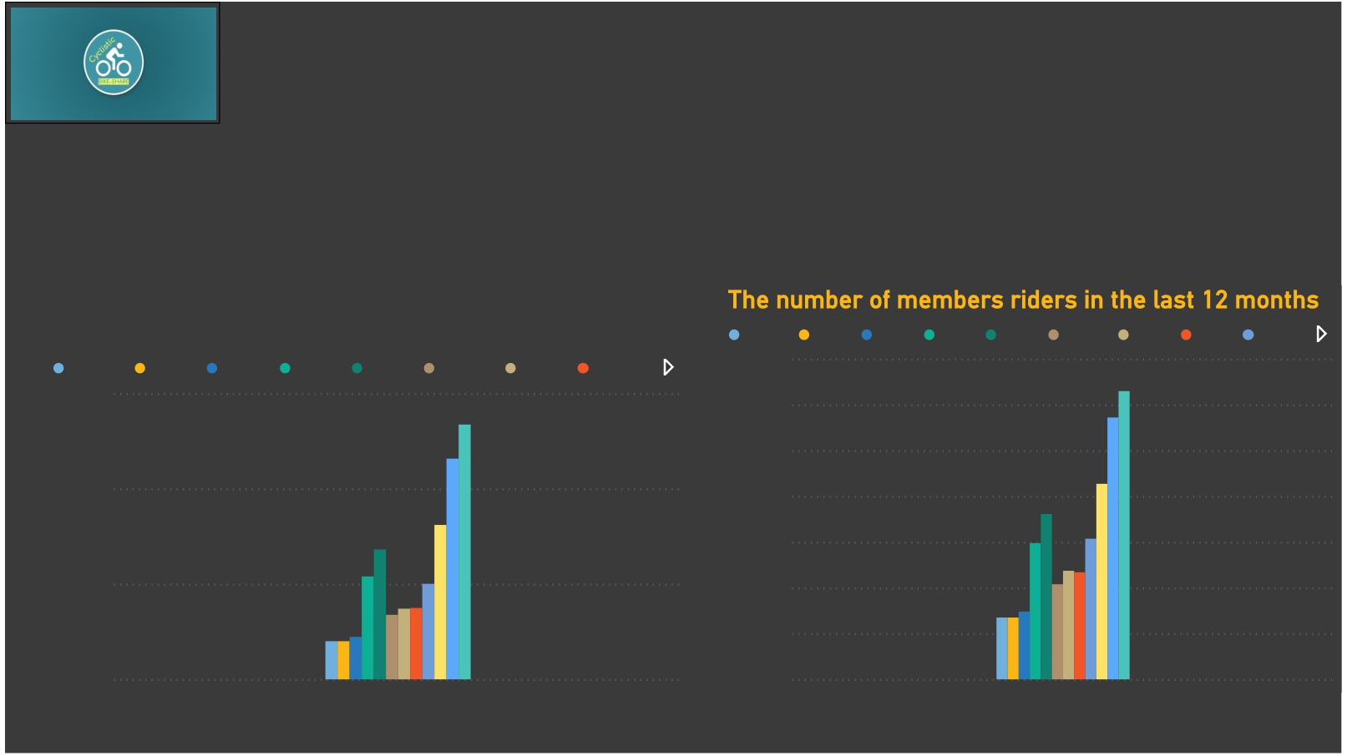
overview the riders
535K
Total riders
315K
Total members riders
220K
Total casual riders
The number of different riders in the last 12 months
12-2021 1-2022 2-2022 3-2022 4-2022 12-2022 1-2023 2-2023
0.6M
0.4M
0.3M
0.0M
12-2021 1-2022 2-2022 3-2022 4-2022 12-2022 1-2023 2-2023 3-2023
350K
300K
250K
200K
150K
100K
50K
0K
12-2021, 1-2022, 2-2022, 3-2022, 4-…
12-2021, 1-2022, 2-2022, 3-2022, 4-202…

Slide 24
Share Data
Now is the time to show all the nitty gritty details of this huge volume of data to break up the problem

Slide 25
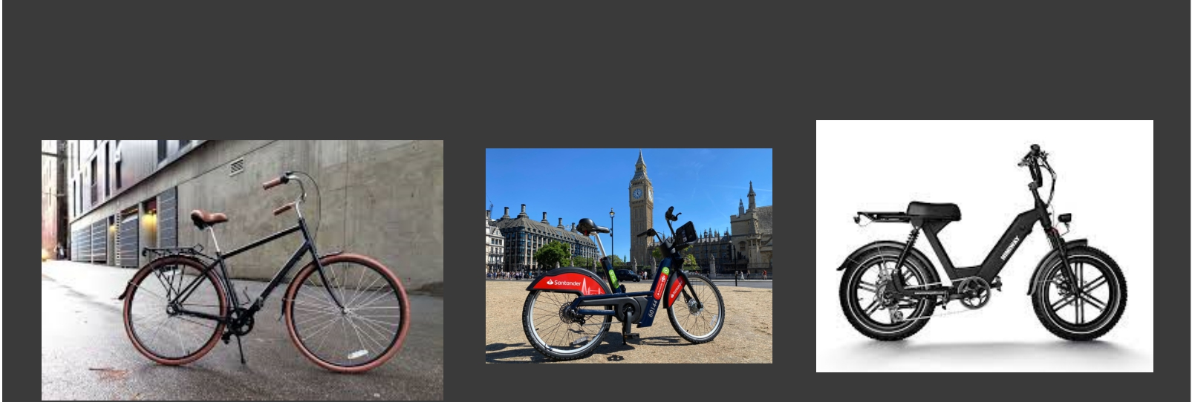
Rider classification for each rider bike
313048
Total Riders for bikes classics
116196
Total Riders for casual riders
196852
Total Riders for members riders
14586
Total Riders for bikes docked
207134
Total Riders for electric_bike
89022
Total Riders for casual riders
118112
Total Riders for members riders
14586
Total Riders for casual riders

Slide 26

Day classification for each member type
Casual members rides days
60K
40K
20K
Members riders days
60K
40K
20K
Sum of casual
Sum of member
0K
fri
thr
wen
sat
sun
tue
mon
0K
wen
thr
tue
fri
sun mon
sat

Slide 27
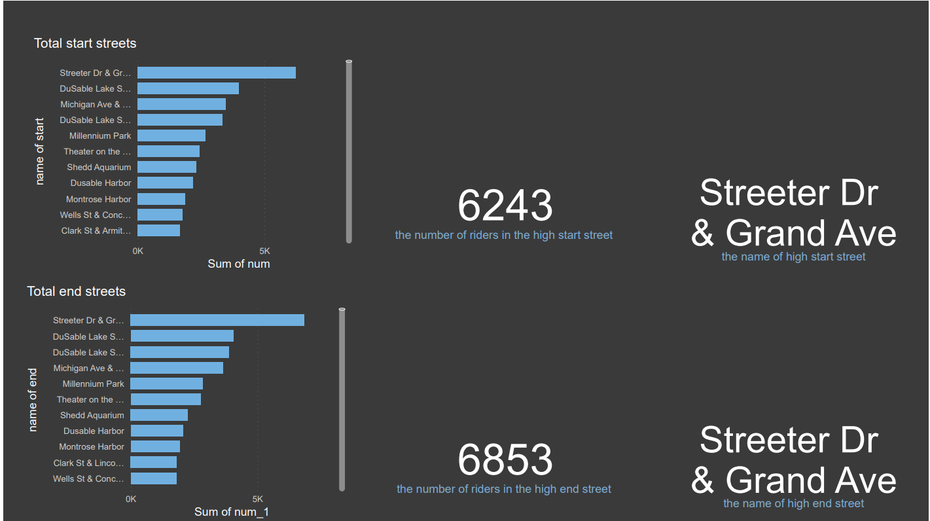
For casual riders

Slide 28
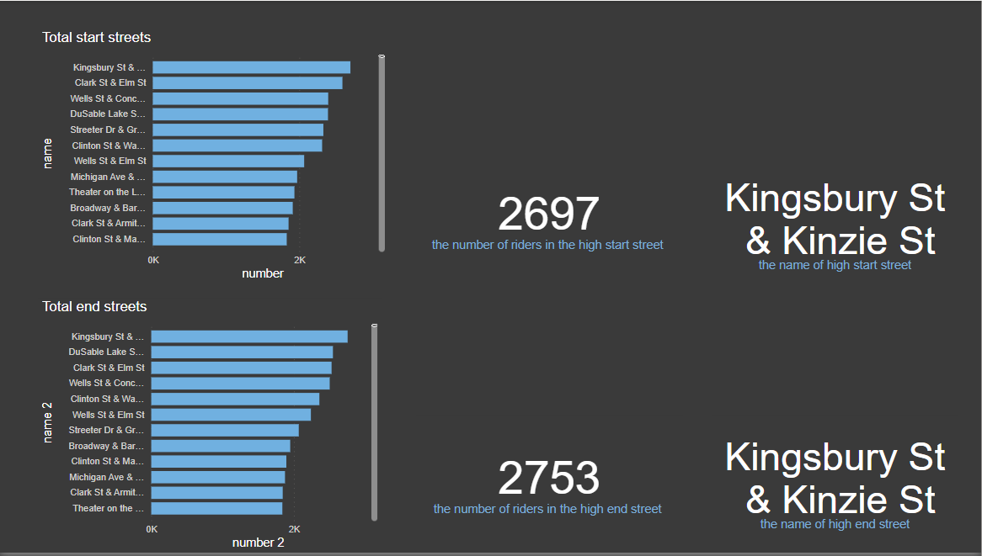
For members riders

Slide 29
Acting data
After all of these steps my conclusion that based on analysis :
The number of members is progressively increasing based on the company's data from the last 12 months.
The number of classic riders is larger than docked and electric bike riders.
Member riders did not use docked bikes.
Most member riders prefer using classic bikes.
Therefore, classic bikes are the best choice for members and casual riders.
The day when casual riders use bikes the most is Friday.
The day when member riders use bikes the most is Wednesday.
Street Dr & Grand Ave has a high number of casual riders starting and ending their trips.
Street Kingsbury St & Kinziest has a high number of member riders starting and ending their trips.

Slide 30
summary
This presentation provided an overview of a data analysis project on the Cyclistic database, highlighting the importance of data-driven decision-making in the bike share program.
The project objectives were to develop and answer business questions to increase the number of members.
The project benefits included improved data quality and accuracy, a centralized data repository for reporting and analysis, and actionable insights and recommendations for business operations."

Slide 31
Thanks

